Slide 1
REPRESENTING NEGATION IN COMPUTATIONAL LINGUISTICS
Challenges and solutions
Massimo Stefan
Alex Astolfi
Filippo Momentè

Slide 2
Index
Introduction
Prevalence of Negation in Natural Language
Challenges in Representing Negation
Symbolic representations of negation
Statistical representations of negation
LLMs representations of negation
Summary

Slide 3
Introduction

Slide 4
Negation
🤔 What is it?
A fundamental construct in both natural language and logic
🧐 Why is it important?​
Fundamental for the expression of
denial, contradiction, and falsity
🔦 How do we spot a negation?
In PL and FOL: ¬ operator
In natural language: very challenging, need a high understanding of semantics

Slide 5
Prevalence of negation in NL

Slide 6
Prevalence of Negation In Natural Language - 1
🔍 The prevalence of negation in natural language is substantial, emphasizing its central role in understanding human communication.
❗There are some cases when modeling negation becomes particular important in NLP, such as:
📸 👩‍⚖️
🔠↔🈹
Different Domains:
🧗Challenge:
The forms negation presents itself can vary significantly across domains.
🧑‍🏫 Example:
Negation in legal texts might exhibit
different characteristics compared to
social media texts.
🤔 Implications for NLP:
Domain-specific approaches for handling negation need to be considered.
2. Machine Translation:
🧗Challenge:
Negation manifests itself differently across languages.
🧑‍🏫 Example:
The syntactic and semantic representation of negation in languages like Chinese or Arabic differs markedly from that in English.
🤔 Implications for NLP:
Negation needs to be encoded differently for different languages

Slide 7
Prevalence of Negation In Natural Language - 2
🔍 The prevalence of negation in natural language is substantial, emphasizing its central role in understanding human communication.
❗There are some cases when modeling negation becomes particular important in NLP, such as:
🎭
📑
3. Sentiment Analysis:
🧗Challenge:
The presence of negation can significantly alter the sentiment of a statement.
🤔 Implications for NLP:
Accurately identifying and interpreting negation is crucial for determining the true sentiment expressed in textual data.
4. Negation Annotation:
🧗Challenge:
Annotating negation in textual data is a challenging task due to its linguistic subtleties and the contextual dependencies that it often entails.
🤔 Implications for NLP:
Effective annotation schemes are essential for creating high-quality datasets.

Slide 8
Prevalence of Negation In Natural Language - 3
🔍 The prevalence of negation in natural language is substantial, emphasizing its central role in understanding human communication.
❗There are some cases when modeling negation becomes particular important in NLP, such as:
🔊
🎣
5. Noisy Text:
🧗Challenge:
Detecting and interpreting negation in noisy text is particularly challenging due to informal language, misspellings, and abbreviations.
🤔 Implications for NLP:
Systems need to be robust against noise.
6. Information Retrieval:
🧗Challenge:
Negation can affect the retrieval of relevant documents in information retrieval systems.
🤔 Implications for NLP:
Understanding negation crucial for matching queries with relevant documents, especially when negation significantly alters the meaning of queries or documents.

Slide 9
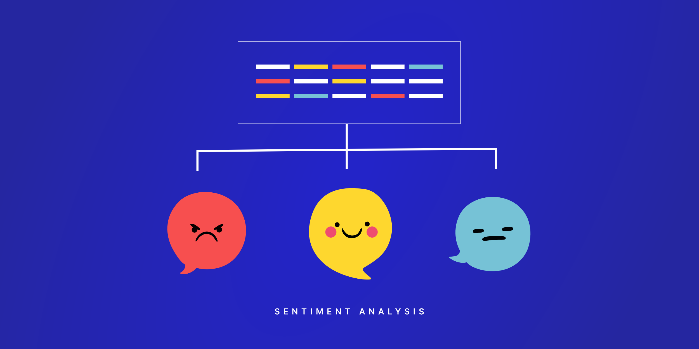



The Importance of Negation for NLP
🔍 A correct representation of negation is fundamental for the results in various areas of Natural Language Processing, such as:
Sentiment Analysis
Information Extraction
Machine Translation
And many more..

Slide 10

The importance for Fake News Detection
🔍 Understanding negations is fundamental also for NLP systems designed for the identification of fake news.
🧰It can aid them to:
Detect trustworthiness
Assess the credibility of headlines
Identify large misinformation campaigns

Slide 11

The Ideal Negation Handling System
🔍 It should be capable of understanding at least five linguistic phenomena:
🎭
🔆🌙
Entailment
Semantic Shift Due to Negation
Antonyms
🥎⚾
➡
Morphological Negation of Adjectives
Implication Understanding

Slide 12
Entailment
💡Idea:
Relationship between statements where the truth of one guarantees that of the other
🧗 Challenge:
Very complex to understand for artificial systems
🧑‍🏫Example:
Statement 1: "He read three books"
Entailment with "He read two" and "He read four" uncertain
Statement 2: "He didn't read three books"
Entailment with "He didn't read four books" more plausible than with "He didn't read two books"
❗Why is it important: failing to understand entailment relationships compromises strongly the capabilities of a system to spot and represent negation

Slide 13
Semantic Shift Due to Negation
💡Idea:
Alteration in semantic relations when negation is applied to phrases or terms
🧗 Challenge:
The changes can appear small, but the meaning may change completely
🧑‍🏫Example:
The phrase "He isn't alive" bears closer semantic resemblance to 'dead' than 'alive'.
❗Why is it important: Recognizing this shift is fundamental for correct semantic embedding.

Slide 14
Antonyms
💡Idea:
Words which present opposite concepts
🧗 Challenge:
A good representation of meaning is required
🧑‍🏫Example:
The opposite of "The weather is warm" is "The weather is cold"
"Cold" is an anotonym of "warm"
❗Why is it important: Accurately handling antonyms is fundamental to ensure precise understanding and identification of negative statements

Slide 15
Morphological Negation of Adjectives
💡Idea:
Involves the use of morphemes to reverse or nullify the meaning of adjectives
🧗 Challenge:
A good understanding of both syntax and semantics is required
These morphemes are quite productive, new negative words can be creared at any time.
🧑‍🏫Example:
"unhappy" vs. "happy"
"inaccurate" vs. "accurate"
❗Why is it important: understanding this phenomena enables to identify negation even in presence of neologisms which may be not present in a dictionary.

Slide 16
Implication Understanding
💡Idea:
Identify the meaning or consequence of statements
🧗 Challenge:
Understanding when a sentence is a consequence of another
This requires also understanding when similar sentences are synonyms and when they have related but different meanings
🧑‍🏫Example:
"The door is not closed" does not imply that "The door is open".
❗Why is it important: Understanding the implications of statements enhances the system's abilities to interpret and respond to negation accurately

Slide 17
Challenges in representing negation

Slide 18
Classic Challenges - 1
📡
Detection of Negation or Modality
👩‍🏫Examples:
"He cannot drive" – "cannot" indicates negation
"It might rain" – "might" indicates modality.
🫷🫸
➿
Scope of Negation
👩‍🏫Examples:
"Not all birds can fly" – negation applies to the phrase "all birds can fly".
" I did not find many valuable books" – ambiguous scope of negation (“find” or “many valuable books”).
Double Negatives
👩‍🏫Examples:
"I can't hardly wait" – intensifies eagerness.
"I can't get no satisfaction" – used for emphasis.

Slide 19
Classic Challenges - 2
Interaction with Modals and Quantifiers
👩‍🏫Examples:
"All students must not leave" – ambiguous interaction of modal and quantifier with negation.
"You shouldn't eat any cookies" – modal and quantifier dictating advisability against action.
Natural Language Inference
👩‍🏫Examples:
Statement: "No dogs are allowed in the park"
Hypothesis: "There are dogs in the park"
Inference should lead to contradiction.
Statement: "Some animals are not permitted in the cafe"
Hypothesis: "No animals are allowed in the cafe"
Inference should not lead to contradiction.
🔠↔🈹
Machine Translation
👩‍🏫Examples:
Translation from English: "I don’t need help“, to French: "Je n'ai pas besoin d'aide“. This may result in "Je besoin pas d'aide", syntactically wrong.
The Chinese phrase "这不是我的书" should translate to "This is not my book." But may result in "This no is my book" due to direct word-for-word translation.

Slide 20
Classic Challenges - 3
📑
Context Dependency
👩‍🏫Examples:
"I haven't seen him in days," may indicate a mild concern in a casual conversation. However, it could imply a more serious concern if the subject was under surveillance.
The statement "I can't believe it's over" could express either relief or disappointment depending on the context.
🔀
Word Order Variability
👩‍🏫Examples:
"I do not think you understand" vs "I think you do not understand". Meaning changes.
In languages with flexible word order (German), the position of negation word can change the scope of negation. For instance, "Ich kann nicht die Türe öffnen" (I cannot open the door) versus "Ich kann die Türe nicht öffnen" (I can open not the door) where the latter might emphasize the inability more.
🃏
Sarcasm and Irony
👩‍🏫Examples:
"Oh, great!“.
Detecting sarcasm requires
understanding the discrepancy between
positive expression and negative context.
"I just love getting stuck in traffic"

Slide 21
Symbolic representations of negation

Slide 22
Symbolic Representations
🔍 Symbolic systems are based on logic, which represent negation in several ways:
Logical Not Operator: ¬P or ∼P, which expresses the opposite of P.
De Morgan's Laws: allow to deal with negation of conjunctions or disjunctions.
Negation as Failure: principle which tells to consider false anything that cannot be proven true, typical of logic programming.

Slide 23
Symbolic Representations - 2
🔍 Symbolic systems are based on logic, which represent negation in several ways:
Quantifier Negation: rules for dealing with negation of existential and universal quantifier by changing quantifier and negating inner proposition.
Other types of logic:
Default-logic: rules assumed true unless there’s evidence of false. Negation is the exception to the rules.
Modal Logic: include modalities such as possibility and necessity. Allows for negation in specific contexts.
Temporal Logic: deals with time and allows for negation in present/past/future

Slide 24
Handling Negation in Symbolic Systems
🔍 Rule-Based Systems: explicit rules specify how to deal with negation and
how to resolve contradictory situations. Originating in the medical field.
📜Strategies:
POS tags: to detect conjunction + negation word in conjunctive phrase (eg NegExpander)
CFG rules: (eg NegFinder)
Trigger Words: list which triggers negation on all words within a fixed window size (eg NegEx)
Dependency parsing: to identify paths between negation trigger and named entity. Anything on the path is considered negated (eg DepNeg)

Slide 25
Statistical representations of negation

Slide 26
Statistical Representations
🔍 Statistical methods form the bedrock of negation representation by learning from data to model linguistic patterns.
📊 Popular statistical models:
Naive Bayes
Support Vector Machines
Neural Networks

Slide 27
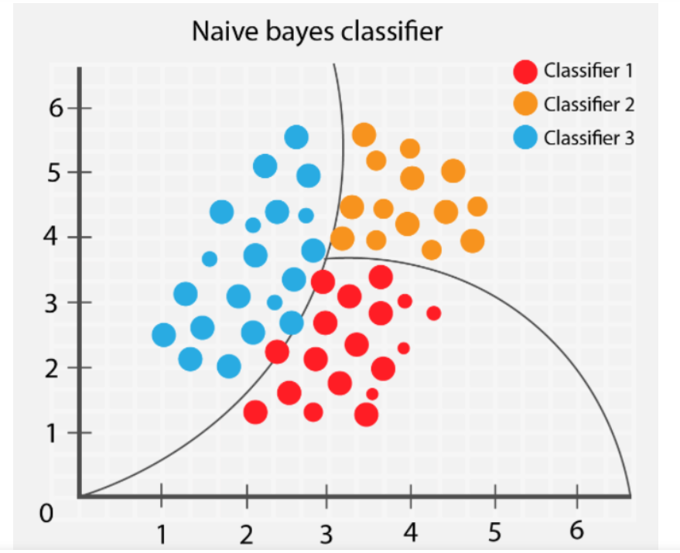
Naive Bayes
💡 Idea:
Utilizes probability theory to estimate the likelihood of negation based on the occurrence of certain indicative words or phrase.
Often reliant on feature engineering to represent negation
🧑‍🏫 Example: binary features indicating the
presence of negation words.
👍 Pros:
Simplicity and ease of implementation.
Efficient in terms of computational resources.
👎 Cons:
It assumes feature independence, complicating the understanding of the semantic nuances associated with negation.
Obtaining results may require extensive feature engineering.

Slide 28
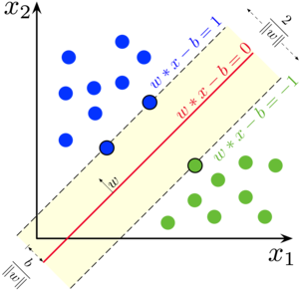
Support Vector Machines
💡 Idea:
Work by finding a hyperplane in a multi-dimensional feature space to segregate negated from non-negated expressions
Primarily dependent on feature engineering for handling negation.
🧑‍🏫 Example: binary features or transformed text to
indicate negation.
👍 Pros:
Effective in high-dimensional spaces and with a well-designed feature set.
Provides a clear margin of separation which can clarify the impact of negation.
👎 Cons:
May also require extensive feature engineering.
Effectiveness can be sensitive to the choice of kernel and hyperparameters.

Slide 29
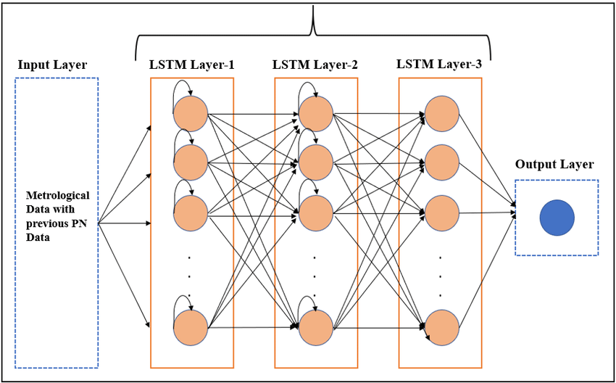
Neural Networks
💡 Idea:
Employ multiple layers of computation to model complex patterns associated with negation.
Can learn the effects of negation from data with sufficient training samples, especially in recurrent or convolutional architectures.
👍 Pros:
Ability to model complex, non-linear relationships associated with negation.
Can learn and generalize well from large datasets.
👎 Cons:
Require a significant amount of data for training to effectively model negation.
Computationally intensive and mostly opaque in terms of interpretability.

Slide 30
Handling Negation in Statistical Systems - 1
🔍 Statistical language models address the issue of negation through various feature engineering methods.
📜Strategies:
Negation Words Detection: trains models to recognize negation words such as "not," "never," "none," which are pivotal as they often flag the presence of negation in a sentence.
Handling Scope Ambiguity: tackling ambiguities in negation scope, i.e., pinpointing which part of a sentence is negated, necessitates sophisticated algorithms. These algorithms weigh the grammatical structure and semantic dependencies within a sentence to rightly interpret the scope of negation.
Sentiment Lexicon: A lexicon of words is created, each associated with a sentiment score. Negation words or phrases can flip the sentiment score of the words/phrases they modify.

Slide 31
Handling Negation in Statistical Systems - 2
🔍 Statistical language models address the issue of negation through various feature engineering methods.
📜Strategies:
Dependency Parsing: Embracing dependency parsing techniques, statistical models comprehend the syntactic relationships between words, aiding in identifying the relations between negation words and the words they modify, thereby, elucidating the scope of negation.
Rule-based Heuristics: Heuristic rules are created to identify negation and its scope based on the occurrence of certain words, phrases, or syntactic structures.

Slide 32
Statistical Systems: Final Remarks
❗It's important to note that the effectiveness of handling negation in statistical language models depends on:
1️⃣ The quality and diversity of the training data
2️⃣ The complexity of the model architecture
3️⃣ The incorporation of linguistic knowledge into the learning process
❕These remarks are also valid for LLMs

Slide 33
LLMs representations of negation

Slide 34
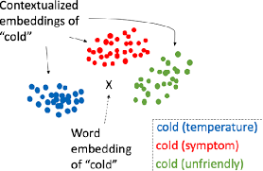
Representations in LLMs
🔍 Large Language Models (LLMs) are Neural Networks (and so statistical), however they
substantially differ from other language models in the amount of data they have been trained with.
❗ They are all Transformers (however not all Transformers are LLMs).
💡They represent negation by building:
Contextual Embeddings: Through their deep architectures, generate embeddings for words and phrases based on their surrounding context, which inherently captures the essence of negation when present.
Continuous Vector Space: The representation of words, including negation, is mapped into a continuous vector space where the semantic and syntactic relationships between words and sentences are preserved.

Slide 35
Handling Negation in LLMs - 1
🔍 LLMs handle negation by using the mechanisms native of Transformer architectures, while exploiting the advantages of being trained on a huge amount of data
📜Strategies:
Attention Mechanism: It allows the weighting of different parts of the input text, enabling the model to focus on negation words and their scope within sentences.
Positional Encodings: Help in maintaining the order of words, which is crucial for correctly interpreting negation.

Slide 36
Handling Negation in LLMs - 2
🔍 LLMs handle negation by using the mechanisms native of Transformer architectures, while exploiting the advantages of being trained on a huge amount of data
📜Strategies:
Training on Large Datasets: By training on large-scale datasets, LLMs learn from numerous examples of negation in natural language, which enhances their ability to correctly interpret negation.
Fine-tuning on Task-specific Data: Fine-tuning LLMs on specific tasks with data containing examples of negation can further enhance the models' ability to handle negation accurately.

Slide 37
Summary

Slide 38
Summary - 1
❓How good are different methods at tackling the classical challenges in representing negation?
➿ Double negatives
🔣 – ⭐
📊 – ⭐
🤖 – ⭐⭐⭐
🎯 Scope of negation
🔣 – ⭐
📊 – ⭐⭐
🤖 – ⭐⭐⭐
📡 Detection of negation and modality
🔣 – ⭐⭐
📊 – ⭐⭐
🤖 – ⭐⭐⭐
♾️ Interactions with modals and quantifiers
🔣 – ⭐⭐
📊 – ⭐
🤖 – ⭐⭐

Slide 39
Summary - 2
❓How good are different methods at tackling the classical challenges in representing negation?
🔠↔🈹 Machine Translation
🔣 – ❌
📊 – ⭐⭐
🤖 – ⭐⭐⭐
💬 Natural Language Inference
🔣 – ⭐
📊 – ⭐
🤖 – ⭐⭐⭐
🃏 Sarcasm and Irony
🔣 – ❌
📊 – ⭐
🤖 – ⭐⭐⭐
📑 Context Dependency
🔣 – ❌
📊 – ⭐
🤖 – ⭐⭐⭐
🔀 Word Order Variability
🔣 – ❌
📊 – ⭐⭐
🤖 – ⭐⭐⭐

Slide 40
References
https://www.sciencedirect.com/science/article/pii/S2667096820300070#:~:text=The%20prefix%20dis,may%20lead%20to%20a (Fake news detection)
https://journals.sagepub.com/doi/full/10.1177/0093650220921321 (Credibility Perceptions and Detection Accuracy of Fake News Headlines on Social Media)
https://aclanthology.org/J12-2001.pdf (Modality and Negation: An Introduction to the Special Issue)
https://mdpi.com/2076-3417/12/10/5209#B77-applsci-12-05209 (<Negation and Speculation in NLP: A Survey, Corpora, Methods, and Applications)

Slide 41
Thank you!
Massimo Stefan
Alex Astolfi
Filippo Momentè

